Slide 1
What Do You See?
AOA
October 20, 2022

Slide 2
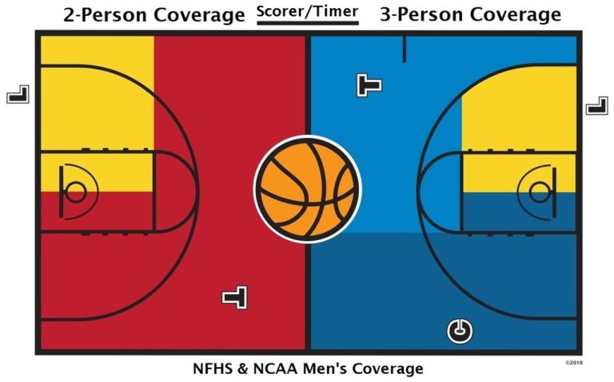
Where are you looking?
NOTE:
To change images on this slide, select a picture and delete it. Then click the Insert Picture icon
in the placeholder to insert your own image.
Know your primary area of coverage.
2-person
3-person
Notes:
Mechanics put us in the best position to see the plays. Need to move to get better looks as the ball and players move around the court.

Slide 3
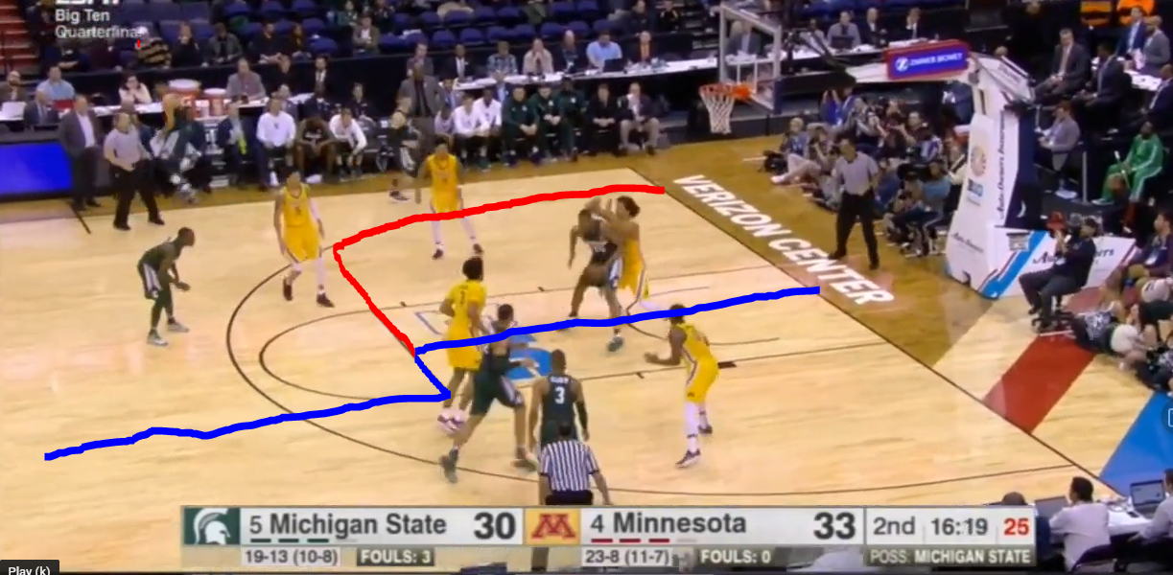
Where are you looking?
NOTE:
To change images on this slide, select a picture and delete it. Then click the Insert Picture icon
in the placeholder to insert your own image.
Know your primary area of coverage.
3-person
Can still use Lead & Trail to learn 2-person
TV games, but NFHS rules
Notes:
Primary areas for 3-person. Watch TV games and think of NFHS rules. Look at the positioning of this crew.

Slide 4
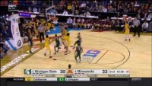
Lead Position: Is there a foul on the play?
Notes:
Ask for input slide. Put yourself in the Lead position. Is he in a good spot? What do you see?

Slide 5
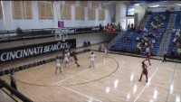
Trail Position: 2 Plays of fake fouls
Notes:
Put yourself in the Trail position. Best spot? What do you see on the plays?

Slide 6
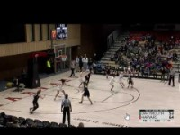
Center Position: Travel or screen foul?
Notes:
Tricky one. Put yourself in the Center position. What do you see?

Slide 7
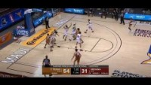
Lead & Trail: Traveling in the lane
Notes:
Just listen to the voice-over explain what happens on this play.

Slide 8
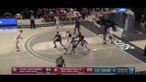
Lead & Trail: Jump stop in the lane
Notes:
Here is a good one. Just listen to voice over.

Slide 9

Trail & Center: 2 Plays with traveling
Notes:
Ask for input first. Trail position first. Center position on second play.

Slide 10
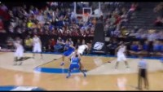
Lead: Rough post play
Notes:
Ask for input first. Put yourself in Lead position. Be ready.

Slide 11
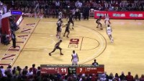
Center: Shooting foul?
Notes:
Center position at top of the screen. Lead position in 2-person. Listen to the voice over.

Slide 12
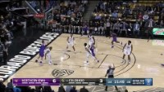
Trail: Shooting foul?
Notes:
Trail position. Listen to voice over.

Slide 13
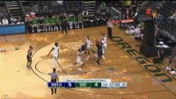
Lead and Center: Free throw rebounding
Notes:
Let the voice over talk.

Slide 14
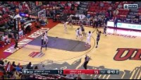
Center and Lead: Rebounding
Notes:
Let the voice over talk.

Slide 15
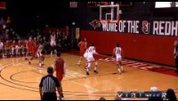
Center and Lead: Rebounding
Notes:
Voice over. Can you mute it?

Slide 16
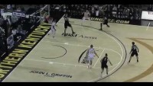
Last one. Stay and help your partner.
Notes:
Voice over explanation of a weird play.

Slide 17
That’s all folks…
Good luck!

Slide 18
Add a Slide Title - 3

