Slide 1
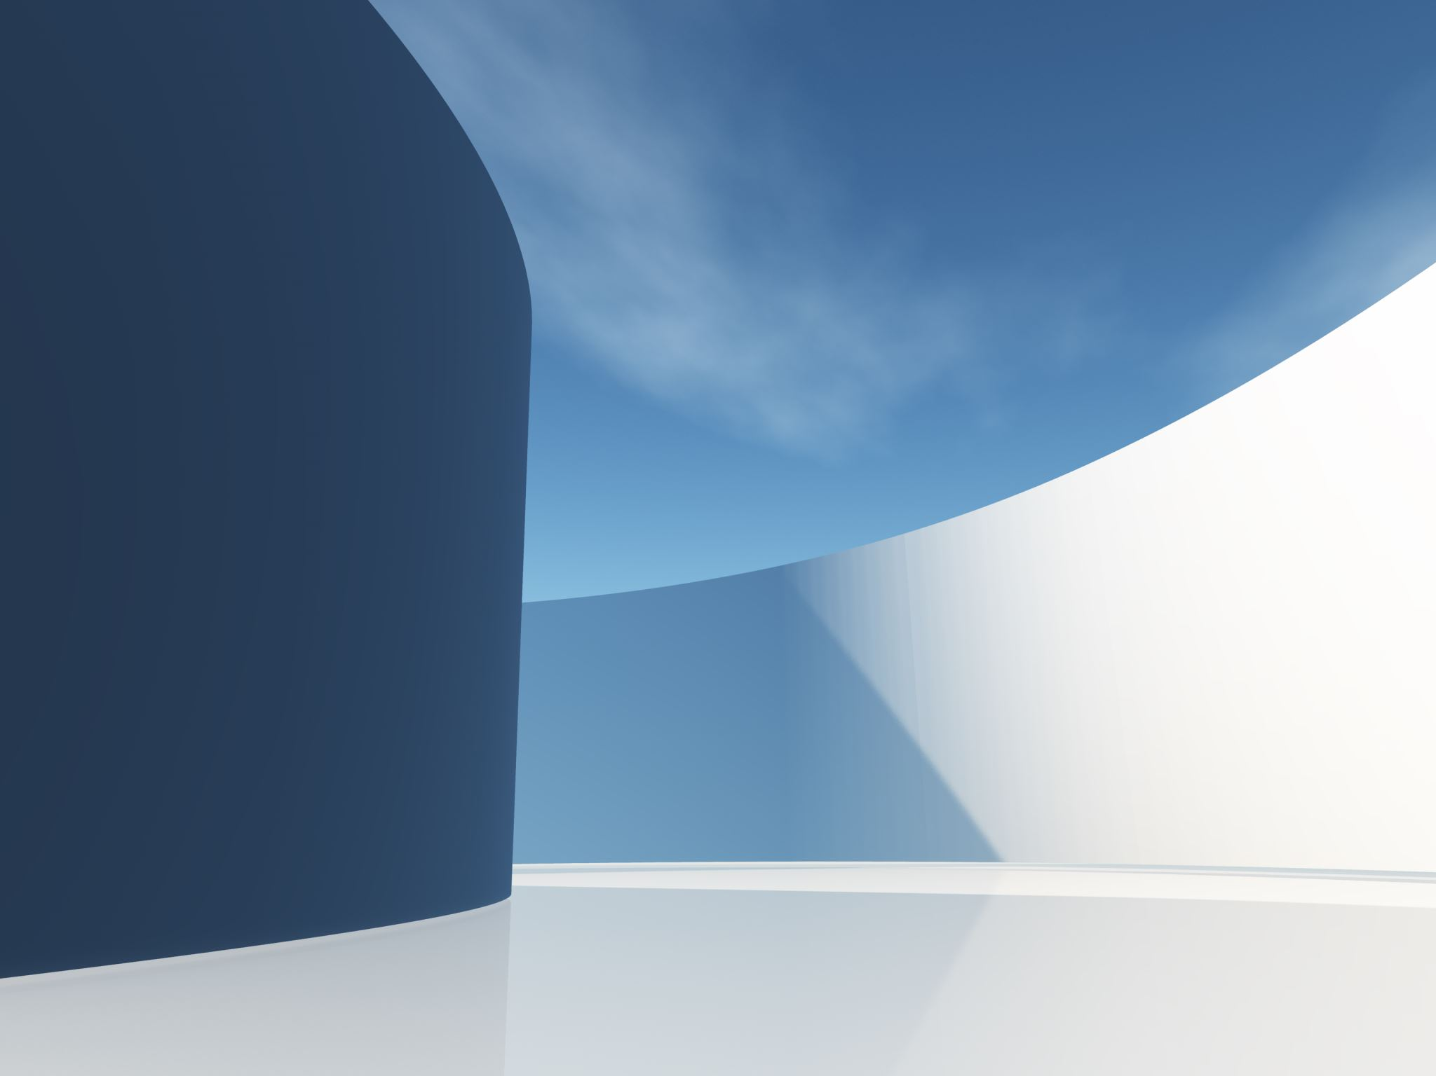
Block/Charge
Tim Loughnane 2022

Slide 2
Rule 4-23 Article 2 - 5
Art 2 To obtain an initial legal guarding position:
A) The guard shall have both feet touching the playing court
B) The front of the guard’s torso shall be facing the opponent

Slide 3
Rule 4-23 Article 2 - 5
Art 3 After the initial legal guarding position is obtained:
The guard may have one or both feet on the playing court or be airborne, provided the guard has inbound status
The guard is not required to continue facing the opponent
The guard may move laterally or obliquely to maintain position provided it is not toward the opponent when the contact occurs
The guard may raise hands or jump within the guard’s own vertical plane
The guard may turn or duck to absorb the shock of imminent contact

Slide 4
Rule 4-23 Article 2 - 5
Art 4 Guarding an opponent with the ball or a stationary opponent without the ball:
No time or distance is required to obtain an initial legal position
If the opponent with the ball is airborne, the guard shall have obtained legal position before the opponent left the floor

Slide 5
Rule 4-23 Article 2 - 5
Art 5 Guarding a moving opponent without the ball
Time and distance are factors required to obtain an initial legal position
The guard shall give the opponent the time and/or distance to avoid contact
The distance need not be more than two strides
If the opponent is airborne, the guard shall have obtained legal position before the opponent left the floor

